Slide 1



Slide 2
Who We Are…
We are Environmental Consultants and Engineers with a fully functional state of the art laboratory based in Ahmedabad.
We provide a comprehensive range of monitoring, consultancy and training services for clients whose activities impact upon natural systems or have the potential to pollute the environment.
The company comprises of a group of dynamic and well experienced chemical engineers, environmental engineers and a wide variety of staff from other fields to form a qualitative work force.
Go Green Mechanisms Pvt. Ltd. is registered with the Gujarat Pollution Control Board (GPCB) under the Environmental Audit Scheme - Schedule II.
Our laboratory is recognized by as an Environmental Laboratory. It is certified under MoEF (Ministry of Environment and Forests)ISO 9001:2008 and OHSAS 18001:2007. The laboratory is also accredited by NABL under ISO/IEC 17025:2017 with over 400 parameters in NABL scope.

Slide 3
Our Testing Capabilities
One Stop Solution
Environmental Consultancy
Environmental Monitoring Services
Water and Wastewater Analysis
Environmental Audits
EC/EIA
Enviro- Legal Services
Ambient Air Quality Monitoring
Stack Emission Monitoring
Ionic Impurities Analysis
Indoor Air Quality Monitoring
Meteorological Monitoring
Workplace Monitoring (Form No. 37)
Water & Waste Water Sampling and Analysis
Noise Monitoring
Post EC Monitoring
Dioxins & Furans Monitoring
VOC Monitoring
Soil Analysis
Solid Waste Analysis
Illumination Survey
Ventilation Survey

Slide 4
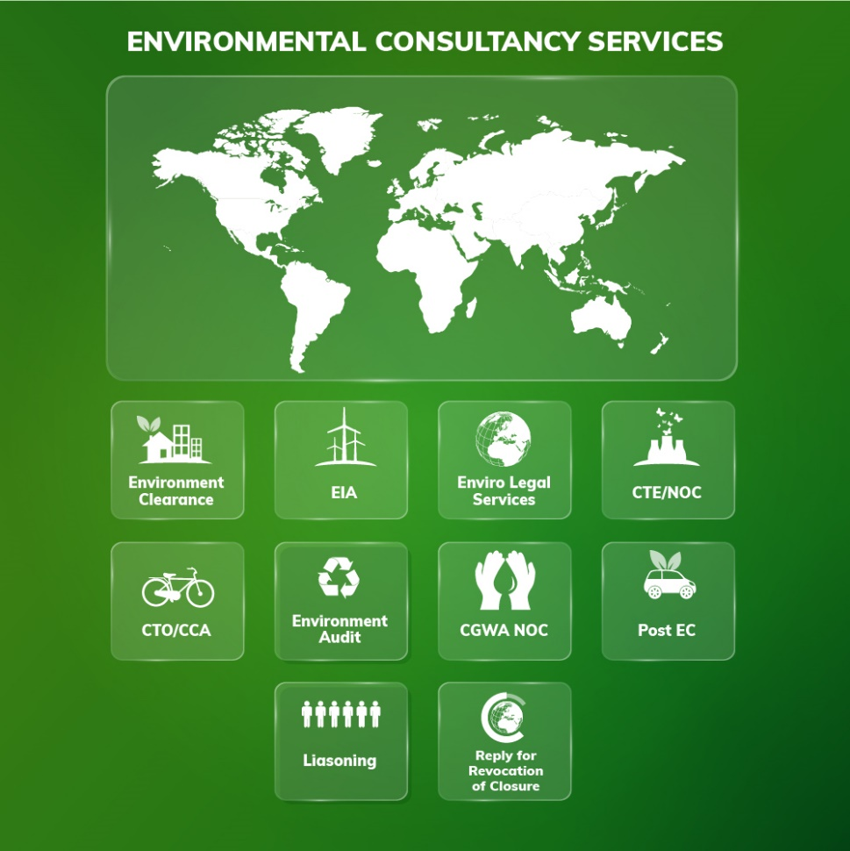

Our Environmental Consulting Capabilities…
You Manage Your Business, We Manage Your Environment

Slide 5
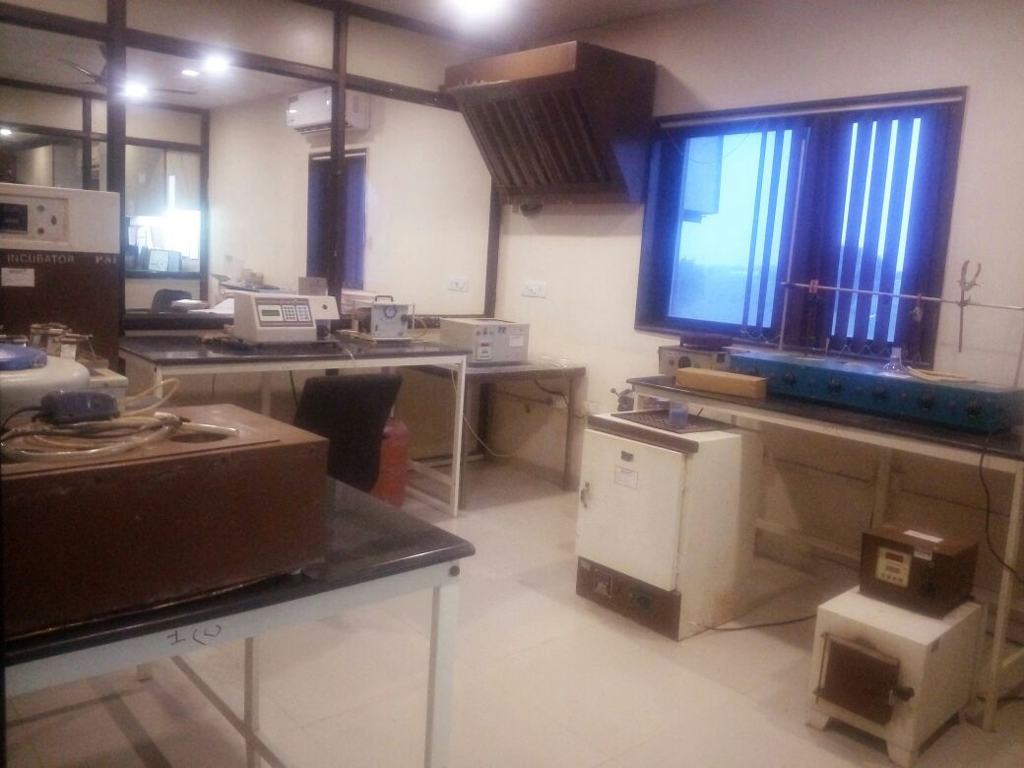
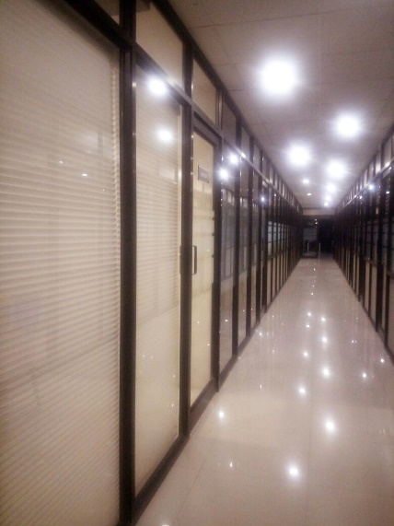
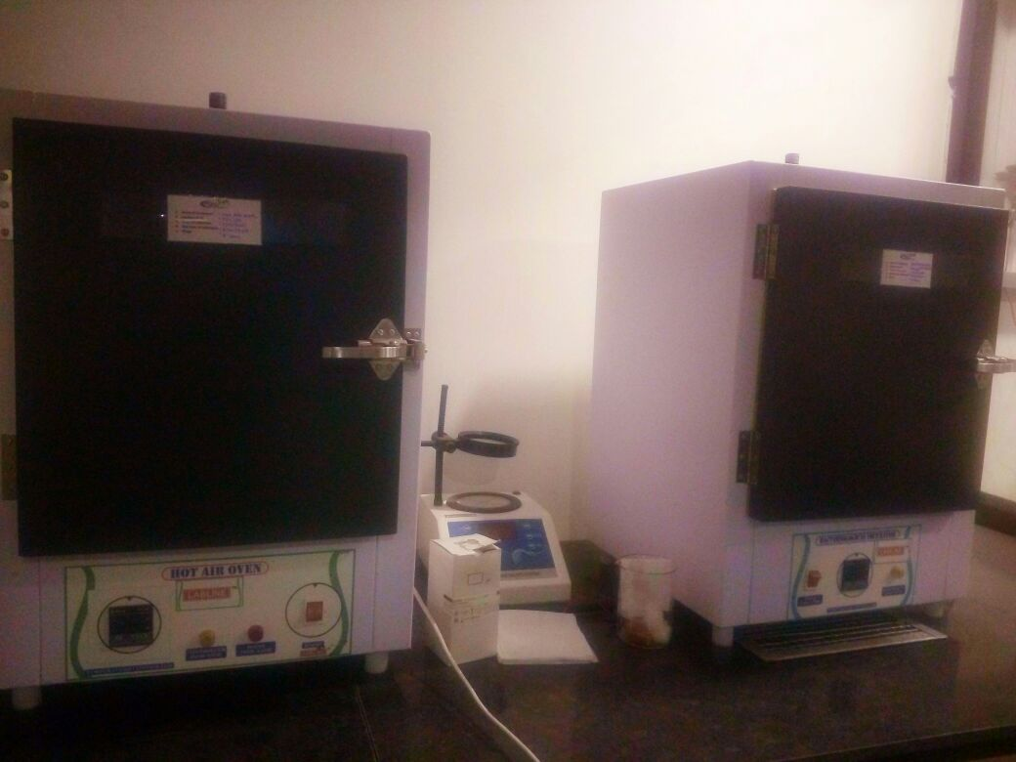
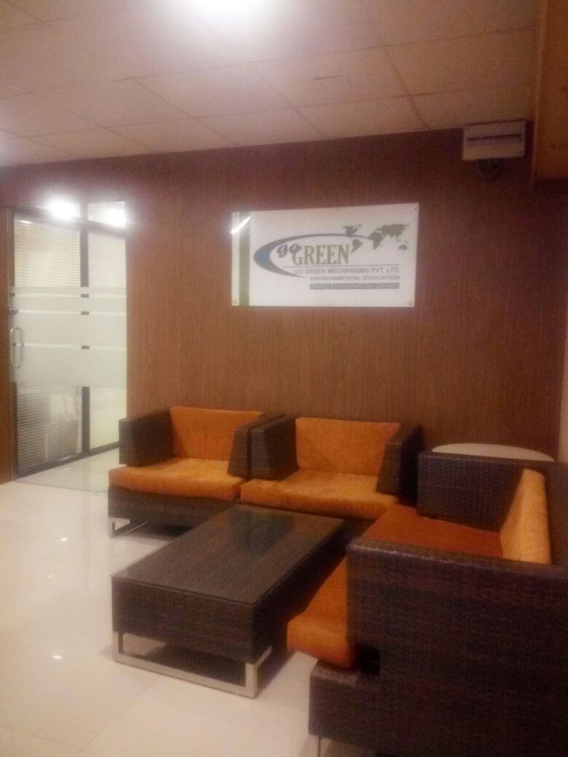
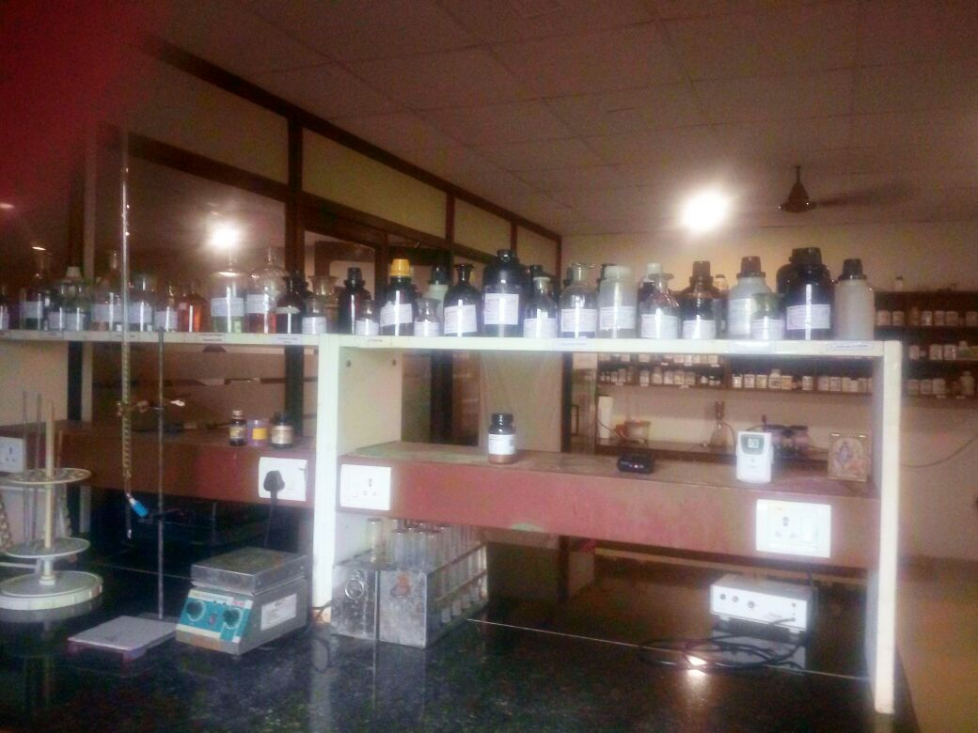
Laboratory Infrastructure

Slide 6
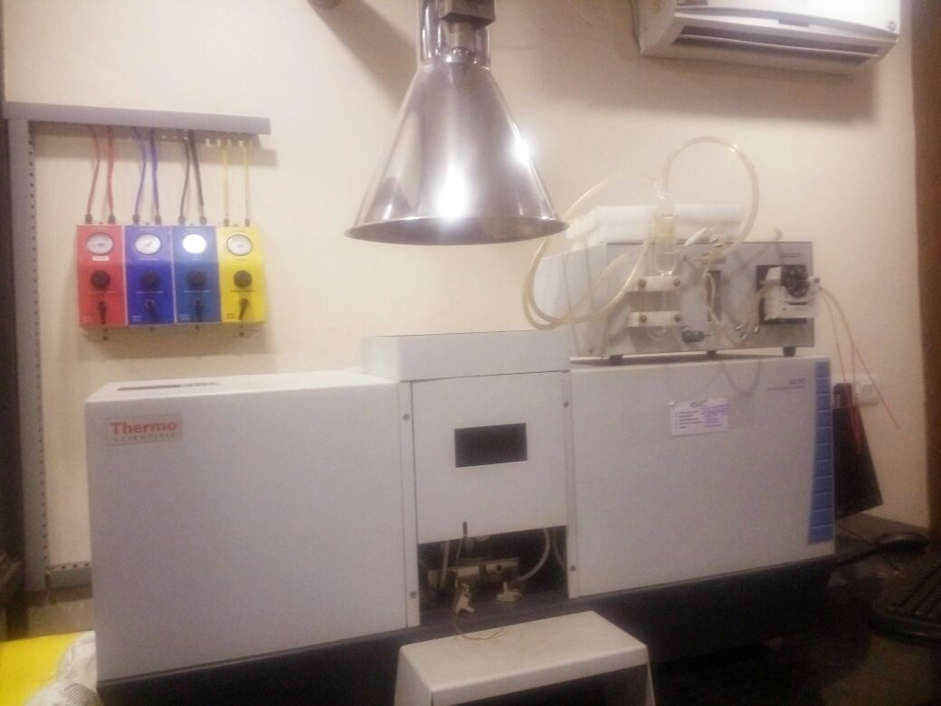
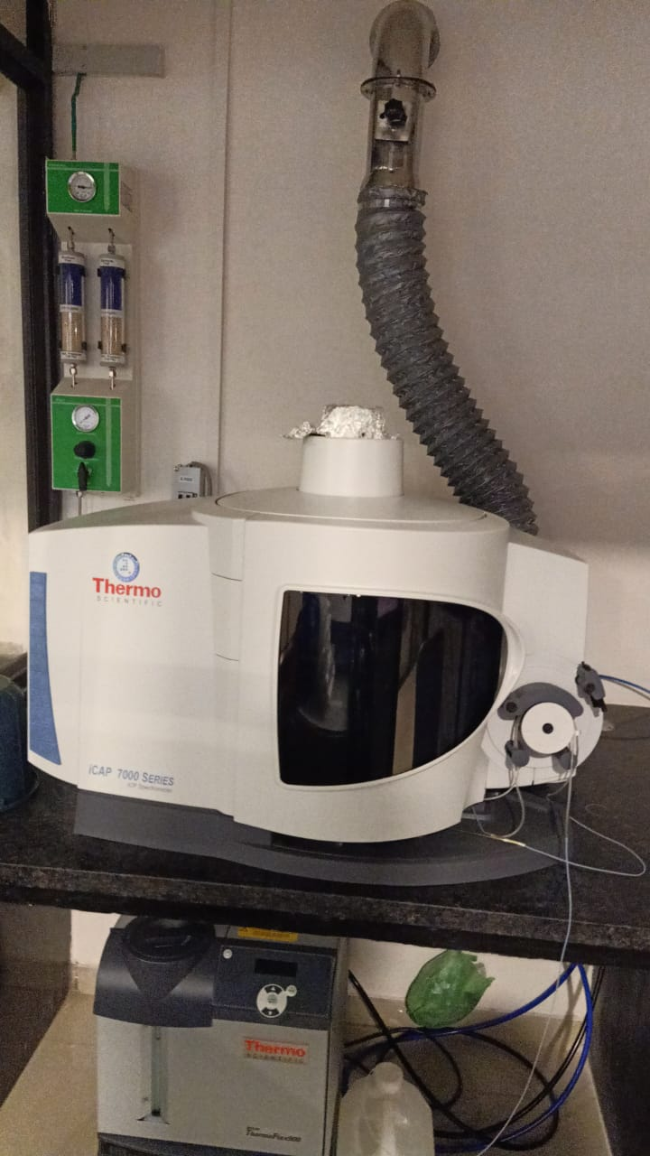
Laboratory Infrastructure
ICP-OES

Slide 7
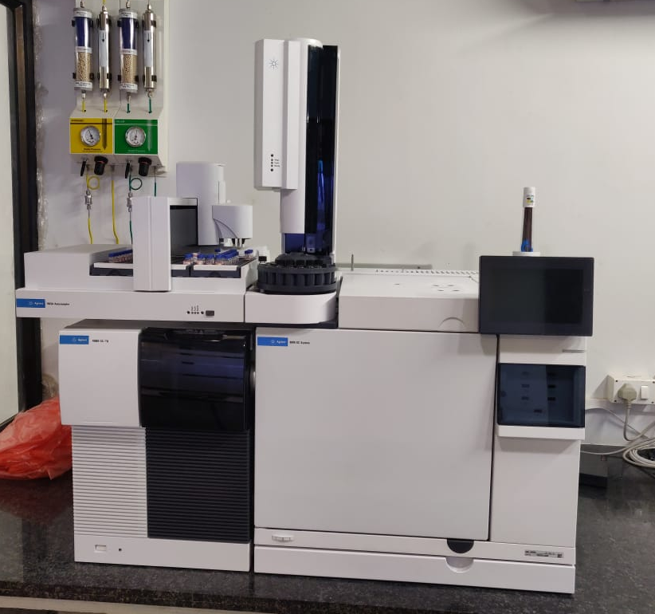
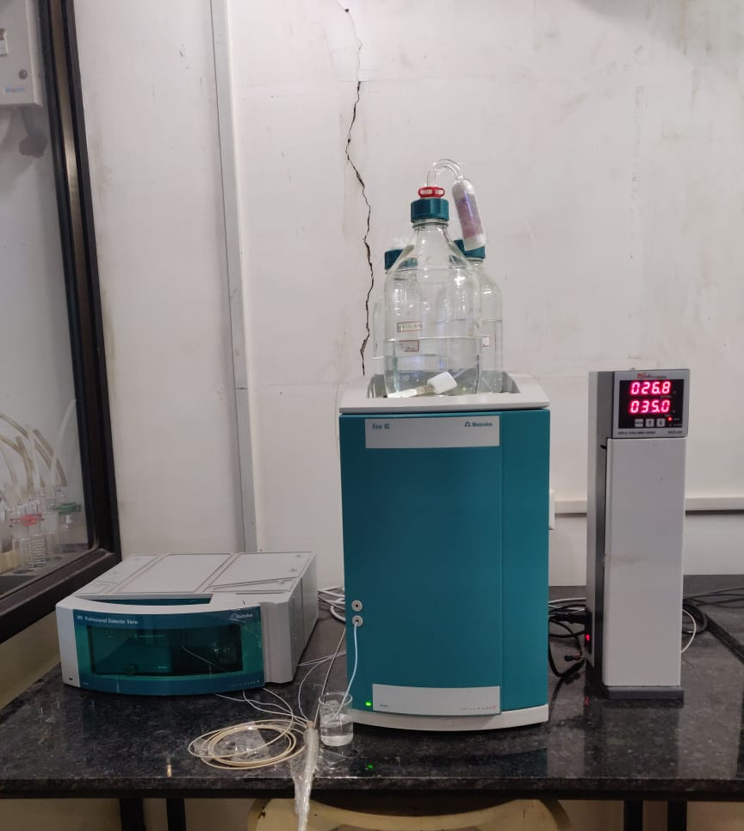
Triple Quadropole GC-MSMS
Ion Chromatography with Amperometric Detector

Slide 8
Proposed Analysis Services for Dyes & Dyestuff Industries
BANNED AMINE TEST BY HPLC/GC/GCMS
BANNED AMINE TEST BY HPLC FROM EXTRACTED FABRIC
INTERMEDIATE TESTING HPLC GC
CHLORIDE % OF DYES
SULPHATE % OF DYES
NA,K,CA,LI % OF DYES
COPPER IN DYES
ASH % OF DYES
LIQUID SPECTRO(DIRECT,ACID,REACTIVE)
TS % OF DYES LIQUID
TDS OF DYES
CONDUCTIVITY OF DYES
SOLUBILITY OF DYES
INSOLUBLITY OF DYES

Slide 9
Our Service
1. Sample Collection at your doorstep
2. Analysis within 2 days of Sampling
3. Analysis Accuracy
4. Frequent Co-ordination
5. Testing At Best Rate
6. Time Commitment

Slide 10
Certification & Accreditations

Slide 11
Certification & Accreditations

Slide 12
Reporting

Slide 13
Work Experience – 13 years (Since 2008)
Western Railways
Northern Railways
Airport Authority of India
Coal India Limited
NPCIL – Kota
NSPCL – Bhilai
Central Pollution Control Board
Rajasthan State Pollution Control Board
Gujarat Mineral Development Corporation Limited – All sites Gujarat
Gujarat State Electricity Corporation Limited - All sites Gujarat
National Marine Development Corporation
L & T ECC
Arvind Limited
Oil & Natural Gas Corporation
Indian Oil Corporation Limited
Adani Ltd.
Alang Ship Recycling Yards
Hindustan Copper Ltd.
Chhabra Thermal Power Plant
J K Cement Ltd.
Torrent Power Ltd.
P & G Ltd.
Rail Wheel Plant

Slide 14
GGMPL Sector Wise Clientele
POWER PLANT
1 | GSECL - Wanakbori Thermal Power Station
2 | GSECL - Gandhinagar Thermal Power Station
3 | GSECL - Sikka Thermal Power Station
4 | GSECL – Ukai Thermal Power Station
5 | GSECL – Uran Thermal Power Station
6 | Chhabra Thermal Power Plant – Chhabra Rajasthan
7 | Akrimota Thermal Power Plant - Akrimota
8 | NSPCL, Bhilai
9 | NPCIL – HWP, Kota
10 | Torrent Power Ltd.

Slide 15
COAL MINES
1 | CMPDI - Bilaspur
2 | CMPDI - Ranchi
3 | CMPDI - Bhuwneshwar
4 | Gujarat Mineral Development Corporation Ltd.
POLLUTION CONTROL BOARDS
1 | Central Pollution Control Board
2 | Rajasthan State Pollution Control Board
OIL & GAS
1 | Indian Oil Corporation Limited (IOCL)
2 | Hindustan Petroleum Corporation Limited (HPCL)
3 | ONGC Ltd.
4 | Sunpetrochemicals Pvt.Ltd.
5 | Reliance Industries Ltd.

Slide 16
STEEL
1 | Hindustan Copper Ltd.
2 | Indian Steel Corporation
INDIAN RAILWAYS
1 | Northern Railway – New Delhi
2 | Western Railway – Sabarmati, Ahmedabad
3 | Rail Wheel Plant - Bela
CONSTRUCTION
1 | L & T ECC Ltd.
2 | Adani Infra India Ltd.
3 | ITD Cementation India Pvt Ltd.
4 | Bilaspur Pathrali Roads Pvt Ltd.
5 | Black & Veatch Private Limited
AIRPORT AUTHORITY
1 | Airport Authority of India - Ahmedabad

Slide 17
CEMENT CLIENTS
1 | J K White Cement Ltd. - Gotan
2 | Udaipur Cement Ltd. - Udaipur
3 | IOCL - Chittorgarh
4 | ACC Ltd.
5 | J K Lakshmi Cement - Sirohi
PHARMACEUTICAL CLIENTS
1 | Torrent Pharmaceuticals
2 | Amneal Pharmaceuticals Ltd.
3 | Cadilla Pharmaceuticals Ltd.
4 | Arysta Lifesciences Pvt Ltd.

Slide 18
FMCG CLIENTS
1 | P&G Ltd.
2 | Hindustan Unilever Ltd.
3 | Bharat Foods Ltd.
4 | Hyfun Foods Pvt Ltd.
5 | Roquette Riddhi Siddhi India Pvt Ltd.
6 | N K Proteins
ENGINEERING CLIENTS
1 | Endurance Technologies Pvt Ltd.
2 | Mitsui Chemicals India Pvt Ltd.
3 | Suprajit Engineering Pvt Ltd.
4 | Seamak Hi Tech Products LLP
5 | Lubi Industries Ltd.
6 | Duke Plasto Technique Pvt. Ltd
7 | Arvind Ltd.
8 | Gunnebo India Pvt Ltd.

Slide 19
OTHERS
1 | MKCI
2 | Jay Bharat Maruti India Ltd.
3 | TATA Consultancy Services
4 | RITES Ltd.
5 | Sintex Industries Ltd.
6 | Silvassa Municipal Corporation

Slide 20

Our Esteemed Clients…

Slide 21
Value Addition
In a nutshell, we offers three things:
1. Relevancy.
2. Quantified Value.
3. Competent Services at affordable pricings.

Slide 22
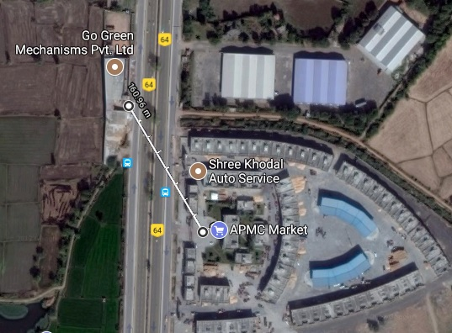
Our Presence
Head office & Lab:
Dayal Estate I National Highway No.8, Opp APMC Market Gate-1(Deen Dayal Grain Market, Bareja), Bareja, Jetalpur, Dist: Ahmedabad-382426
Contact Details:
Email: amit@gogreenmechanisms.com
Mobile No. - 9727056865

Slide 23
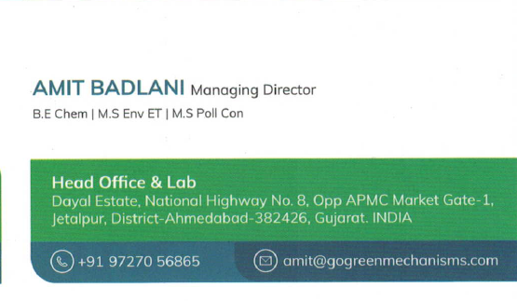


Slide 24
THANK YOU !
We look forward to working with you
- Team Go Green Mechanisms Pvt. Ltd.

