Slide 1
Corporate Presentation of Raybon Group
PT-Module RO plants for Effluent recycling , Desalting and dye-concentration
Polyelectrolytes for sludge dewatering and clarification
Antiscalents for MEE plants
Steam free evaporators in plastic MOC – waste heat evaporators (wHE)

Slide 2
About us
We have been, supplying chemicals and equipemnts for industrial water treatment since the year 1994.
With employee strength of over 250 people, within the group, we have engineers, chemists, technicians and field personnel who can ensure accurate dosing and remarkable results of our chemicals on the field. We have our own laboratory and go-down to ensure both quality products and services along with dependable logistics.
Our products are specialty chemicals like polyelectrolytes, defoamers, antiscalants, dewatering polyelectrolytes, de-oiling polyelectrolytes, bacterial cultures etc. Although we deal in a variety of chemicals our focus remains in the water and wastewater treatment sector

Slide 3
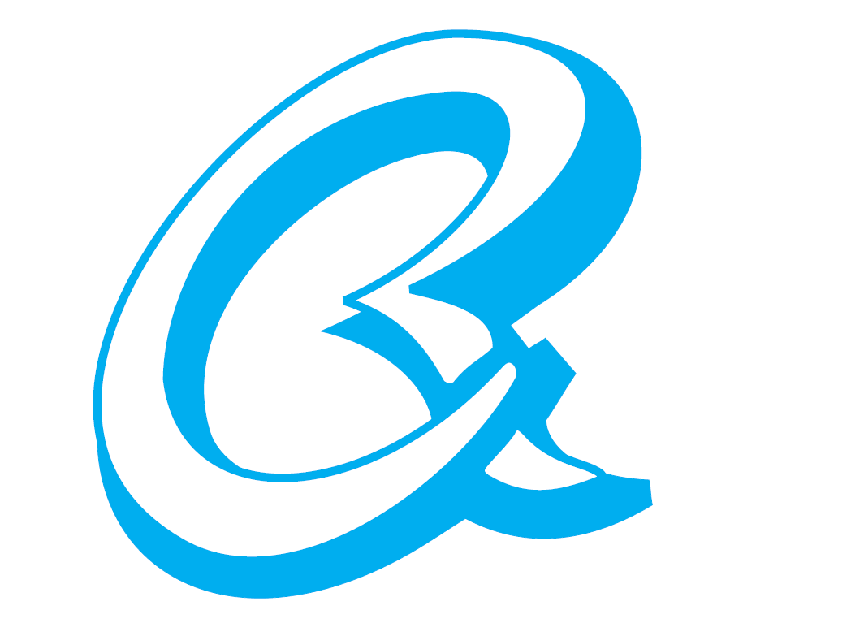
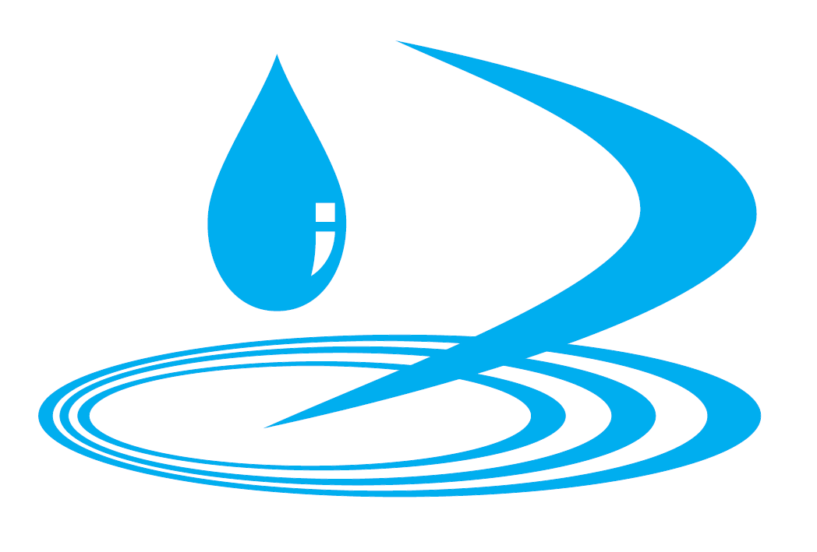
Raybon group of companies
Raybon Chemicals and Allied Products
Zero Discharge Systems Pvt. Ltd.
Outperforming polymers with outstanding services
Clean water from effluent water

Slide 4
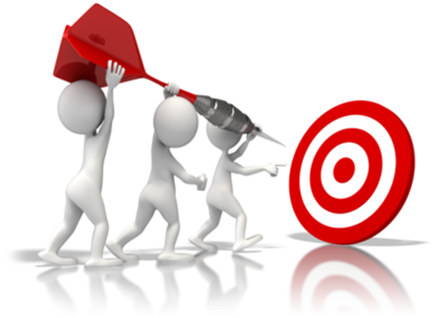
Mission Statement
We shall endeavor to always be the market leaders, by bringing forth to our customers the best and the latest, cutting edge technologies and products, in the field of water and wastewater treatment and recycling.
We shall always deliver to our customers outperforming products with outstanding service
We shall always remain committed to the paradigm that unless the results are measurable, the solutions cannot be trusted, and deliver products and solutions that are sustainable, not just environmentally but economically also.
We shall always measure our success based on the amount of money we have saved for our customers rather than the amount of money we have earned from them.

Slide 5
Product Portfolio
PT RO
Polyelectrolyte
MEE Antiscalant & Antifoam
RO Antiscalant & Cleaning Chemicals
Defoamer for Aeration Tank
Waste heat evaporators

Slide 6
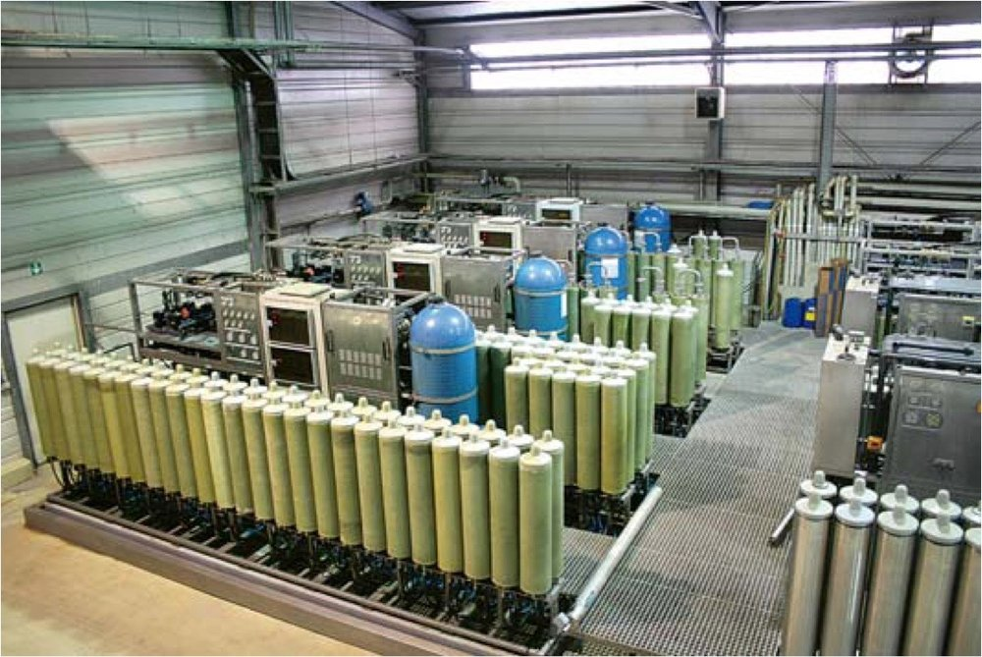
PT –Module RO Plants
PT-module makes it possible to treat & recycle industrial waste water for wide range of industrial applications
PT-module RO plants specifically designed to run on high COD/TDS effluents.
Large number of running installation 150 in Gujarat and 2000 in India

Slide 7
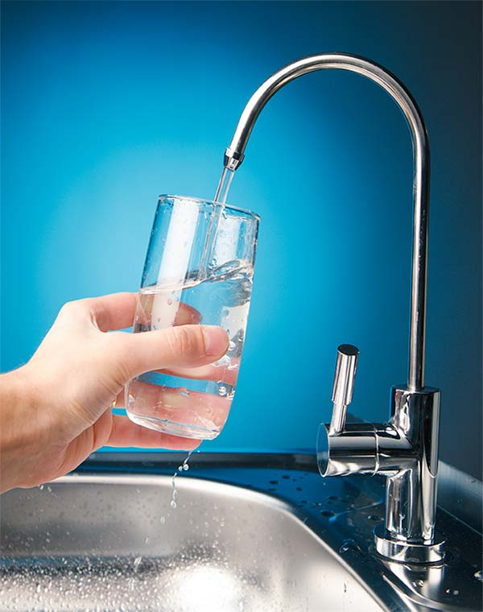
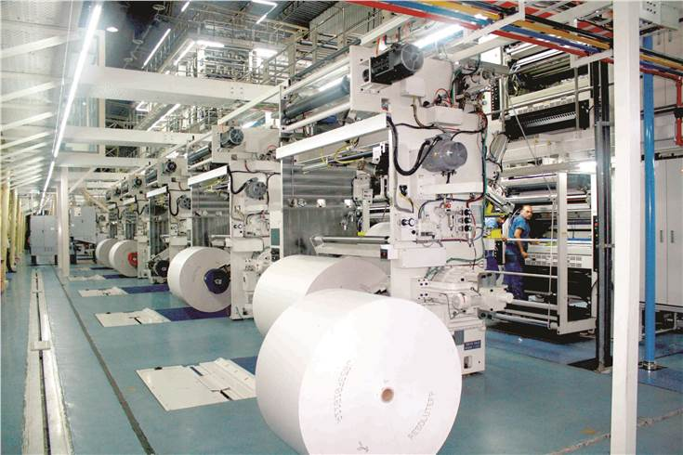

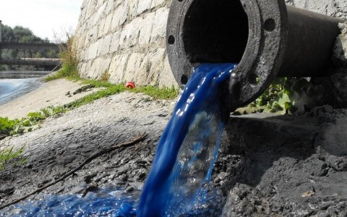
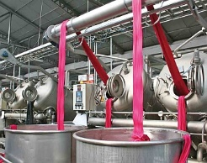
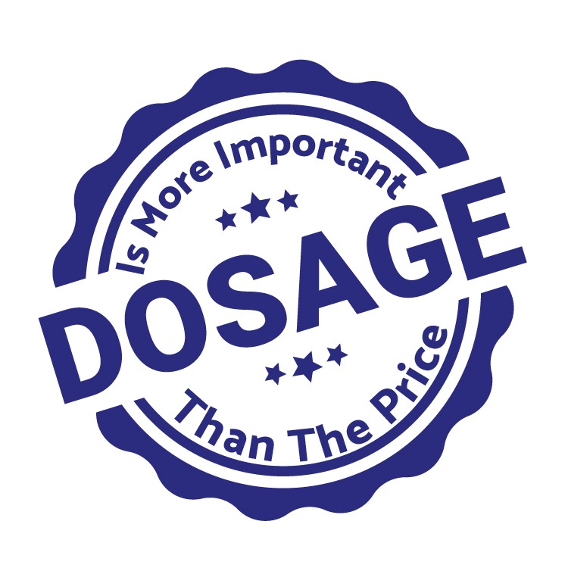
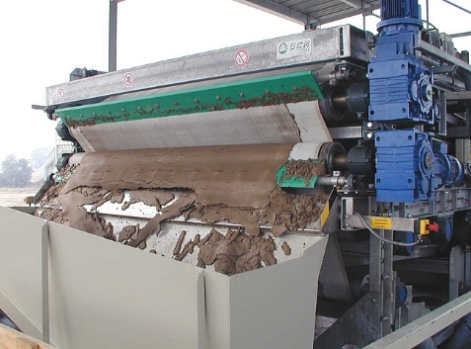
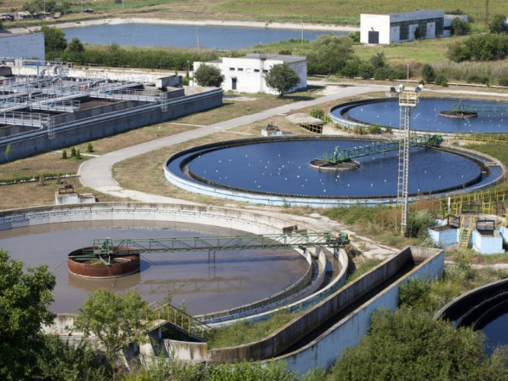
Polyelectrolyte
Complete range of molecular weight and ionic charge flocculants and coagulants for primary, secondary and tertiary clarification.
Significant dosage reduction of up to 20%
Cake solids of dewatered sludge can be increased by up to 15%
Improved centrate quality with reduced suspended solids.

Slide 8
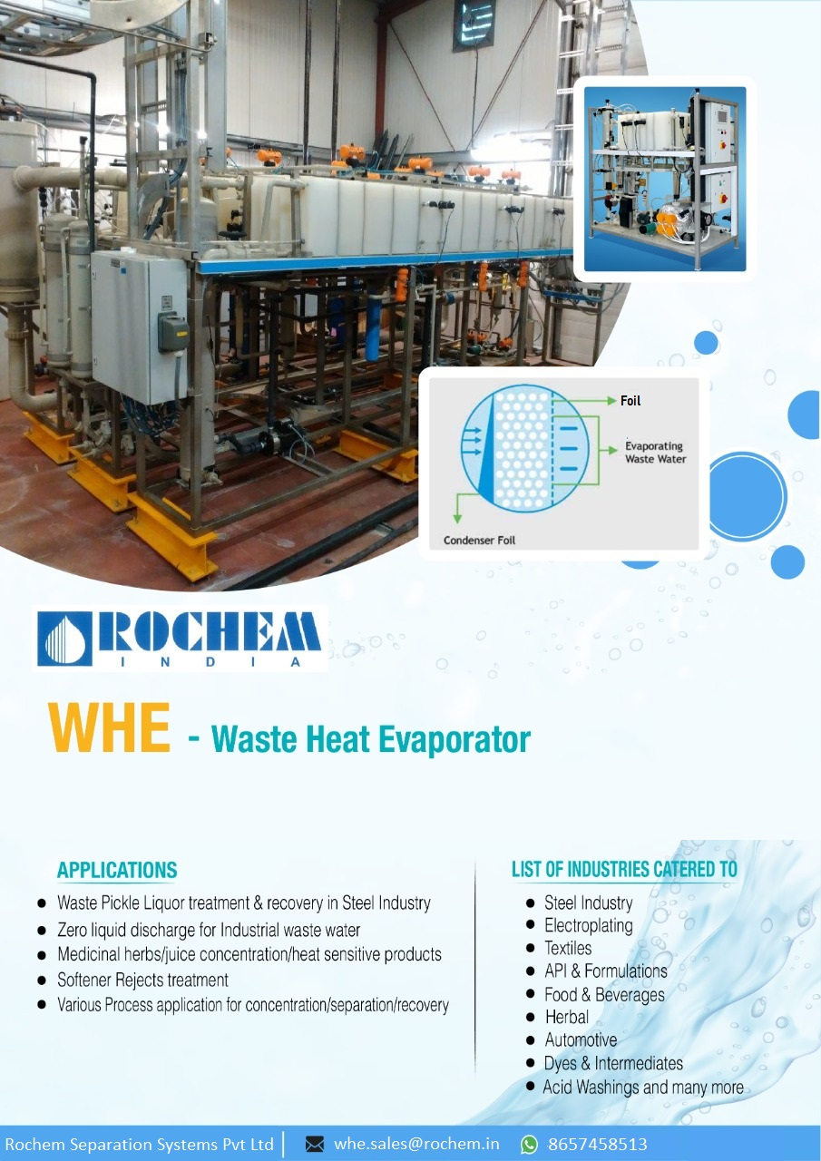
Steam free evaporators in plastic MOC – waste heat evaporator ( WHE )
SALIENT FEATURES OF WASTE HEAT EVAPORATOR (WHE)
· Economical and energy Efficient.
· Reduces Equipment size and Hence Lower foot print.
· Easier Maintenance.
· Structural Supports are not required.
· Low Electrical energy requirement.
· Low operating Pressure.
· No Corrosion issues.
· Alternate Source of Heat can be utilized.
.

Slide 9
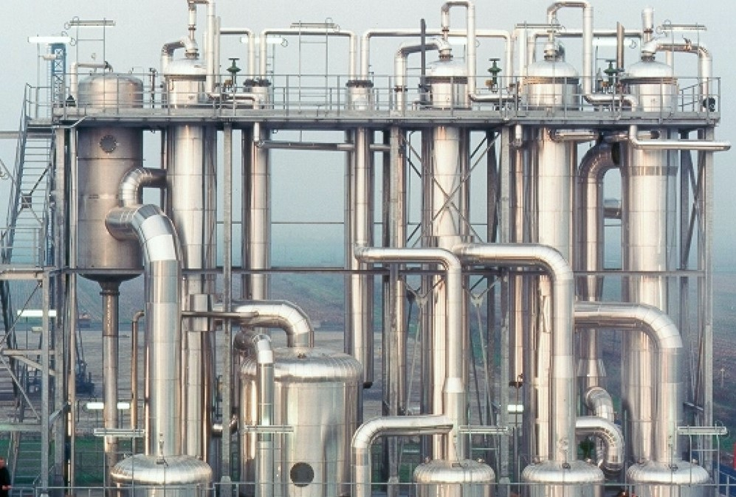
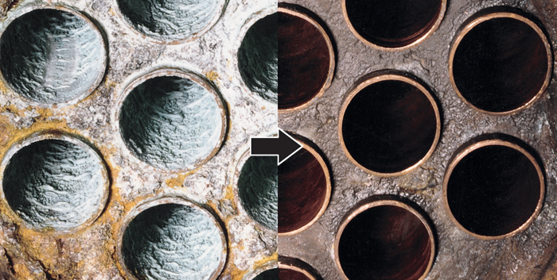
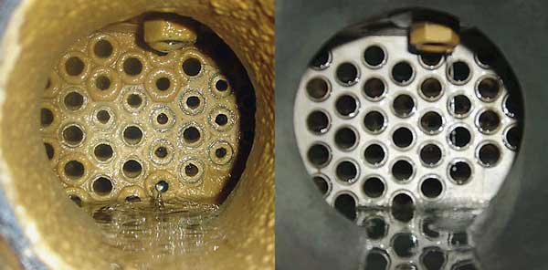
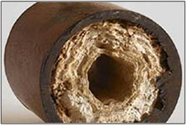
MEE Antiscalant and Antifoam
Retards scale formation
Low dosage rate as compared to other Antiscalant
Modifies scale morphology and generate easy to clean scales
Increase uptime &reduces downtime by increasing operational hours between two cycles
Give excellent foam control at low dosage
Destroy foam & inhibits foam formation

